Slide 1
OTC Medicines and Common side effects
Archana Suryawanshi
Apurva Kadam
Saloni Alshi

Slide 2

CONTENTS
01
INTRODUCTION
02
OBJECTIVE
03
DATA COLLECTION AND GRAPHICAL REPRENTATION
04
METHODOLOGY AND ANALYSIS
05
RESULT AND CONCLUSION

Slide 3
INTRODUCTION:
OTC medicines are those medicines that can be taken from medical stores without any doctor's prescription.
The trend of 'Over-the-Counter (OTC) Medicines use has grown steadily in the last few years. Various reasons such as easy availability, affordability, and increased awareness among patients are responsible for this trend.
The Over-the-Counter medicines market is always under investigation due to its nature of self-medication.
Factors like attitude is considered in consumers as the determinant of the over-the-counter medicine purchase decision. Demographic factors play an important role in influencing consumer behaviour towards OTC products. Demographic variables include- family income, gender, age, occupation, education qualification.

Slide 4
Types of OTC medicines & their uses, side effects:

Slide 5
OBJECTIVE:
The study was conducted to investigate consumer perception regarding safety, availability, and marketing strategies of OTC product available in pharmaceutical market.
The study also aimed to investigate the various influencing factors contributing to an individual’s brand of choice decision within the over-the-counter (OTC) medicine available in pharmaceutical market. Furthermore, consumer attitude and individual norms was also examined to determine whether they make impact on consumer intention to repurchase the same OTC medicine brand.
So, our main objective is, to understand customer buying behaviour towards OTC medicines because of their side effects.

Slide 6
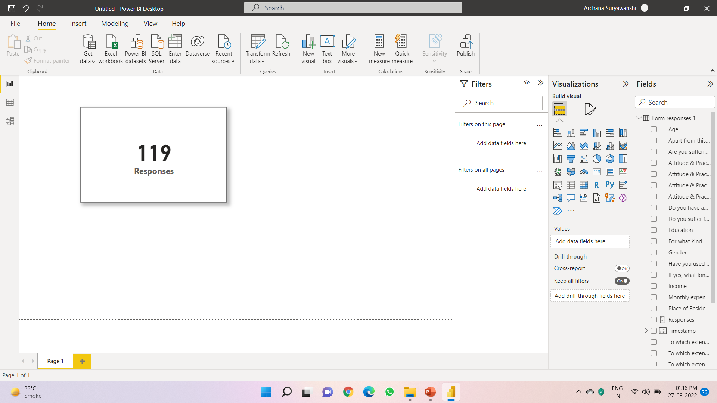
DATA COLLECTION:
The data is collected by creating google form and responses are analysed using R studio and graphical representation done by Power BI .
119 Responses were collected through Questionnaire.

Slide 7
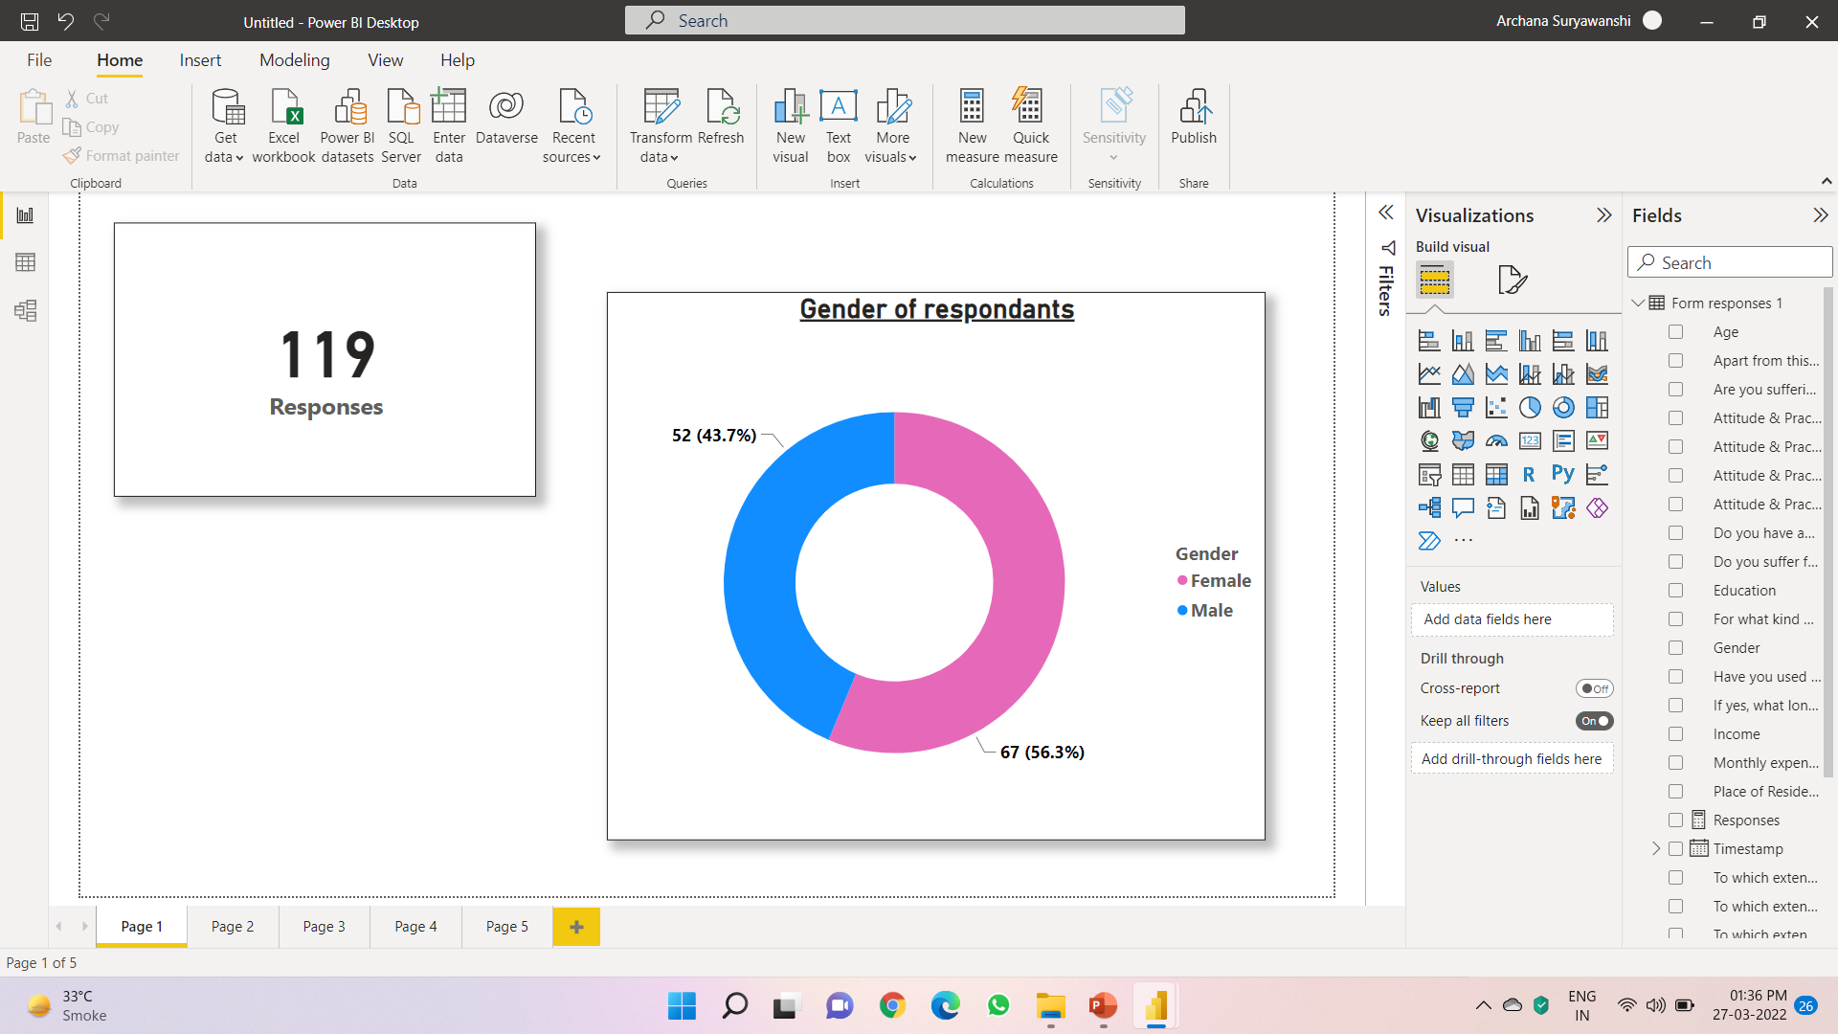
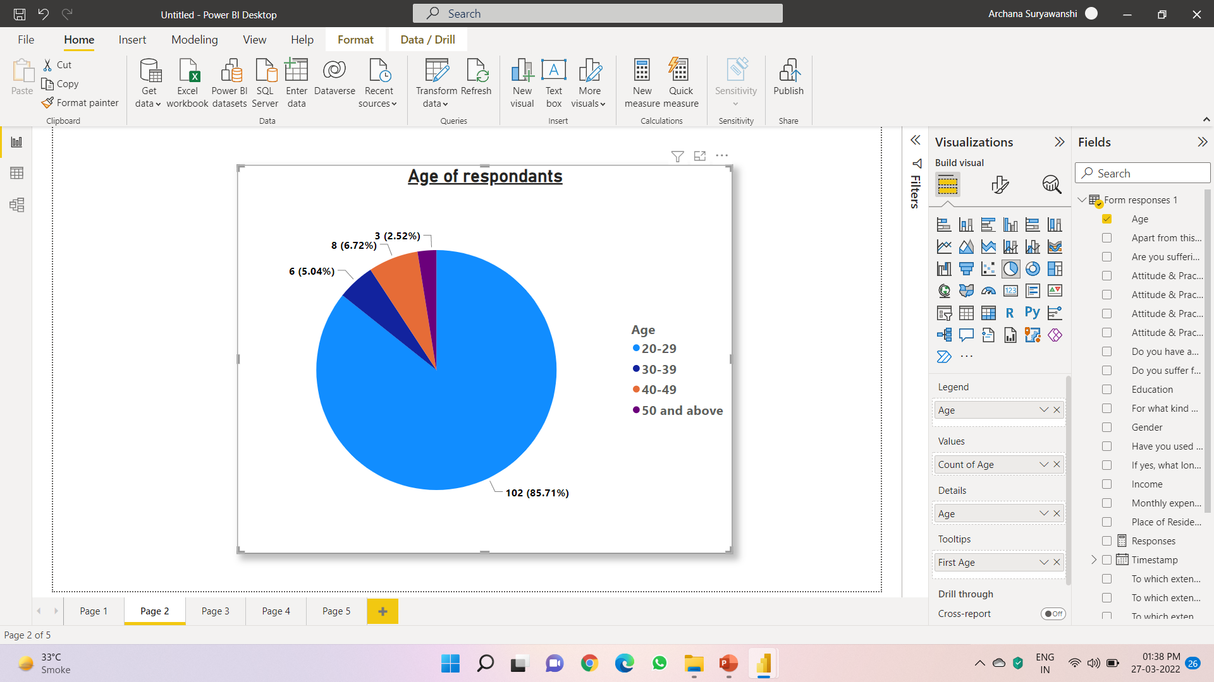
GRAPHICAL REPRESENTATION

Slide 8
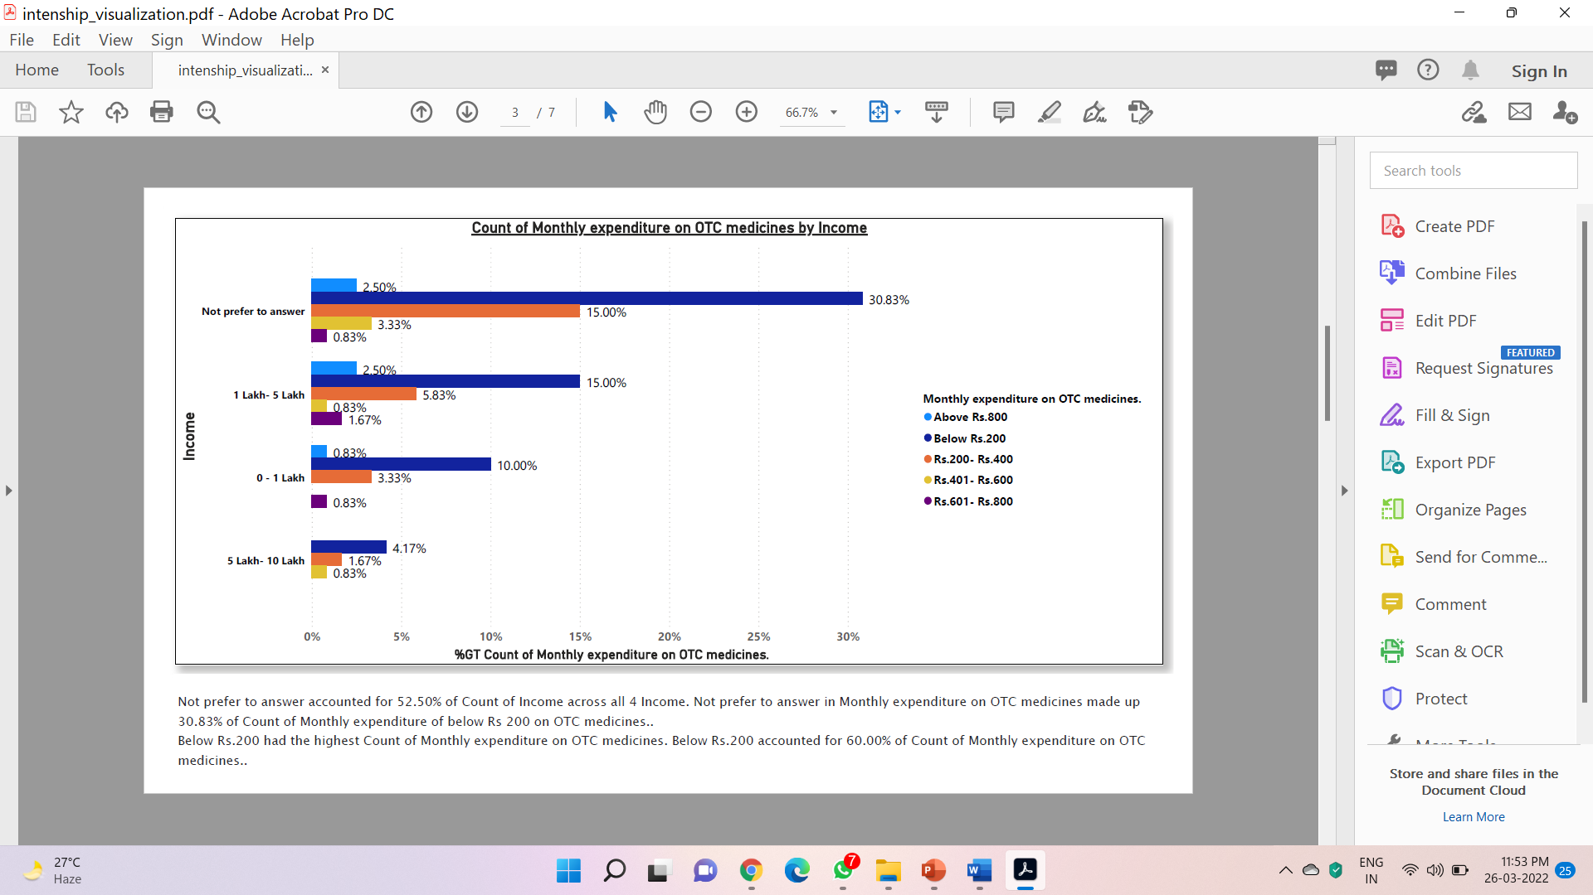
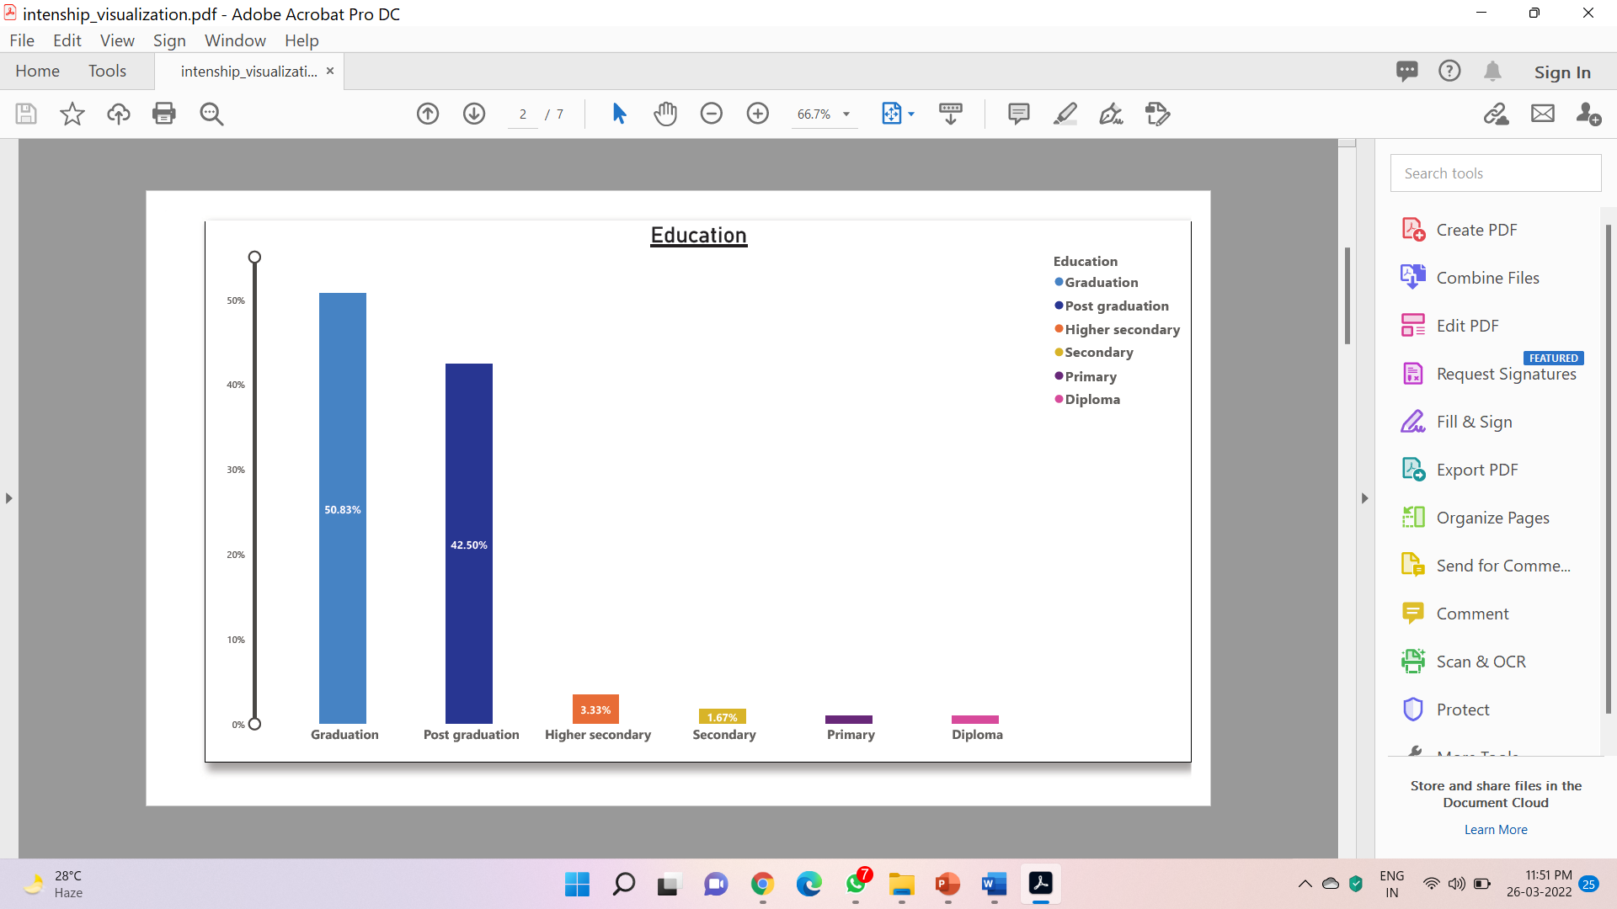

Slide 9
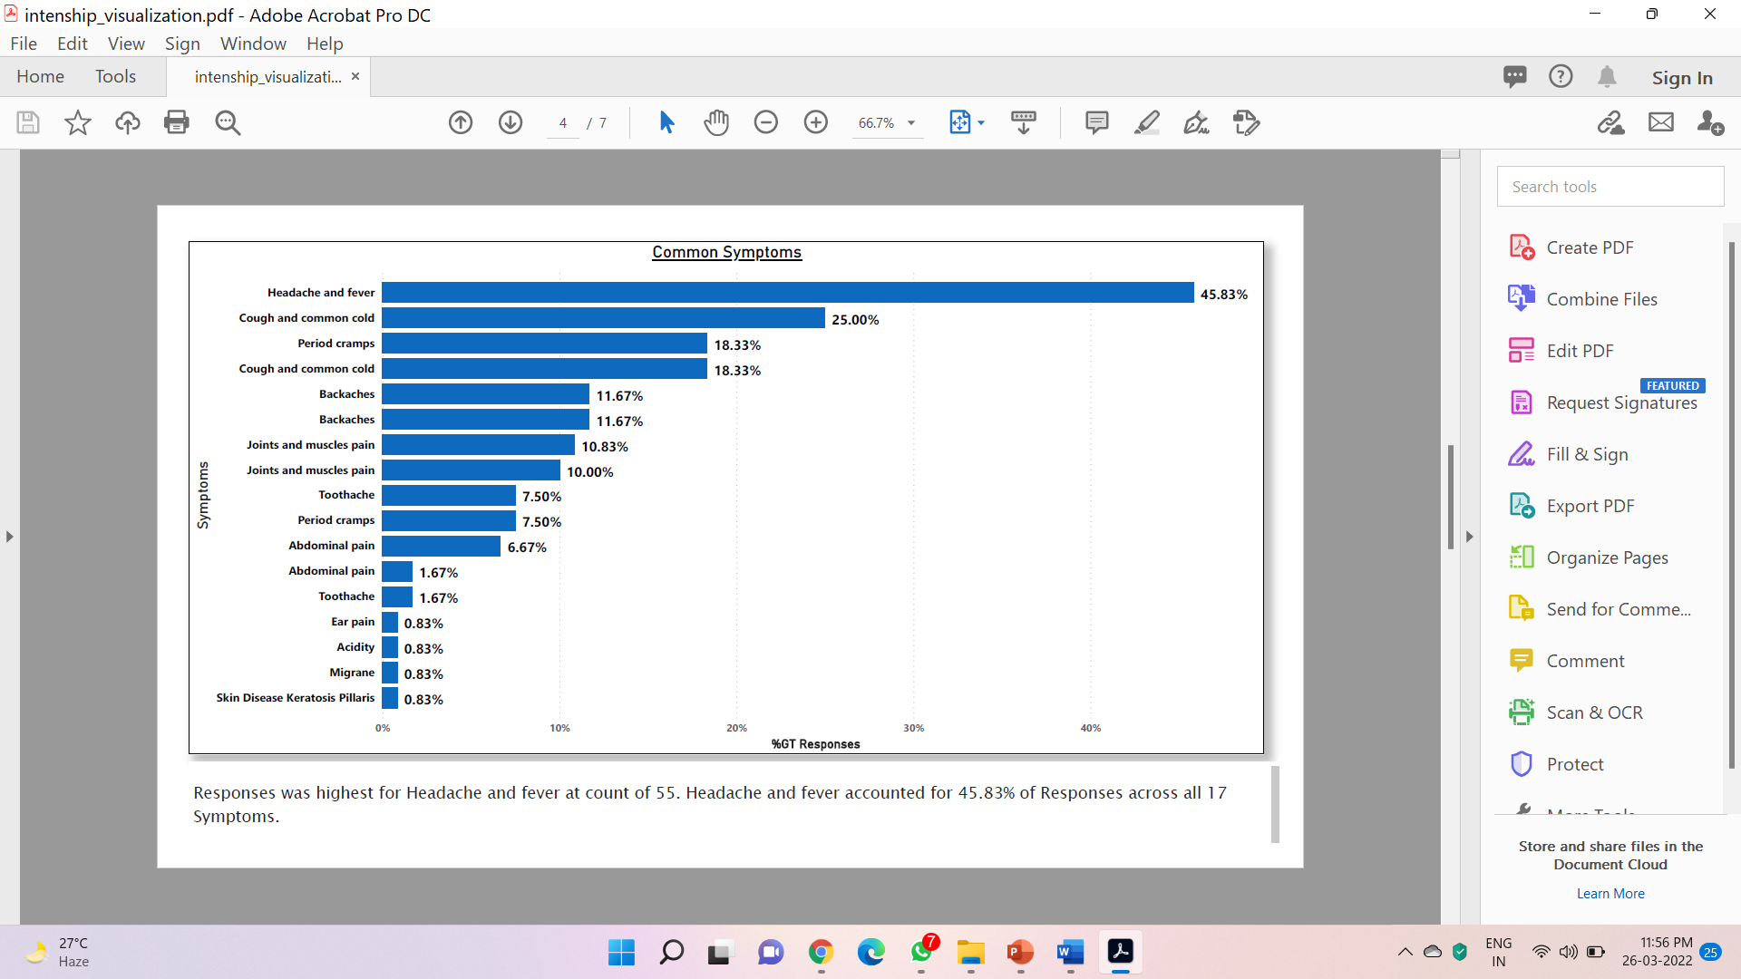
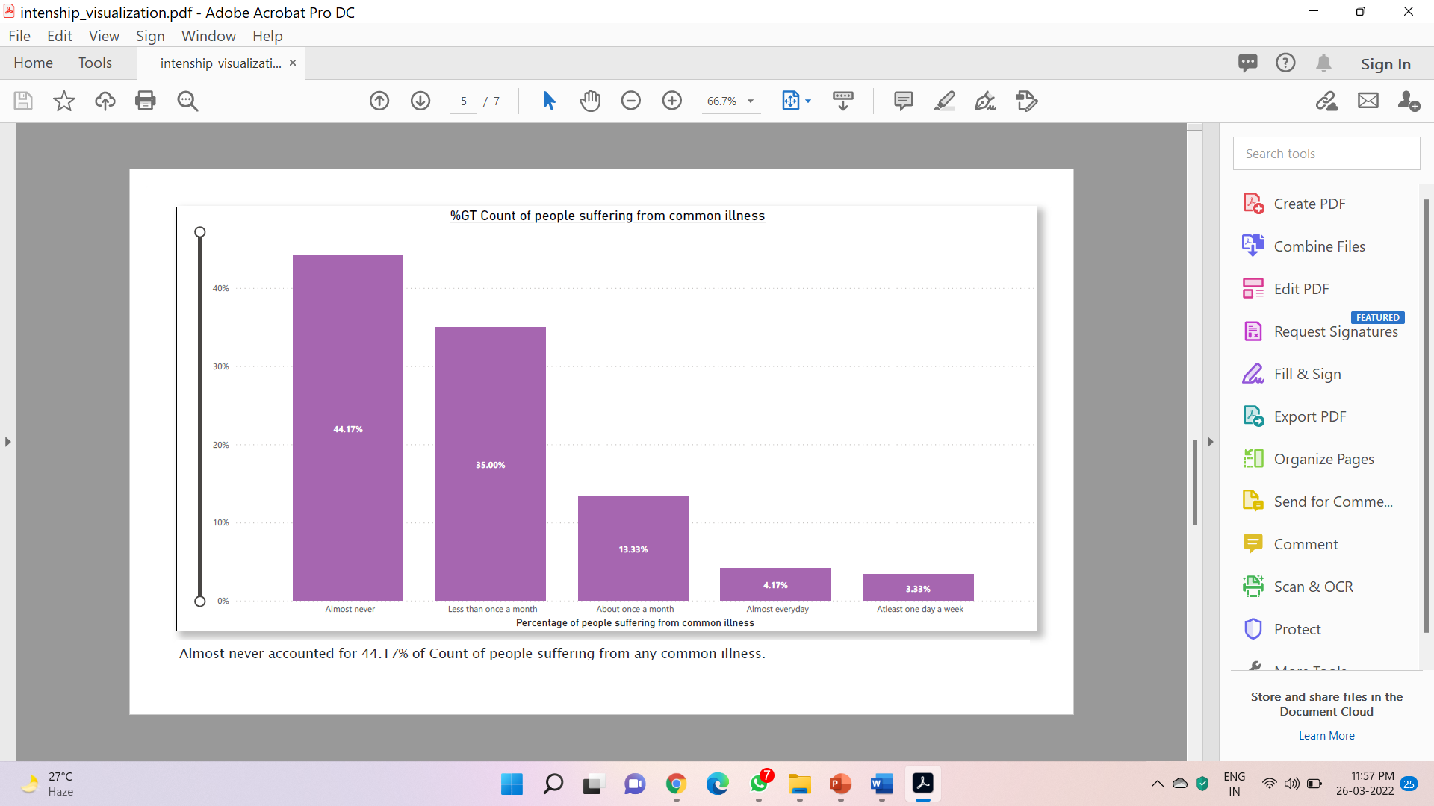

Slide 10
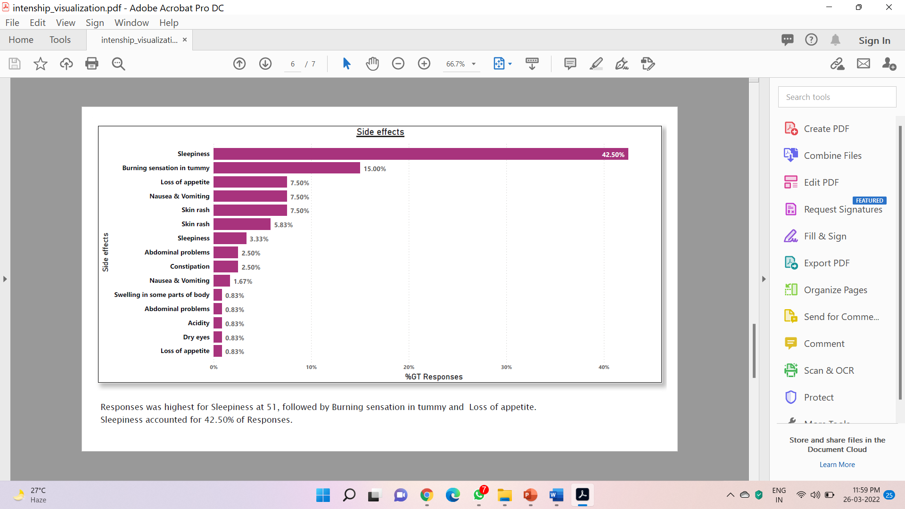
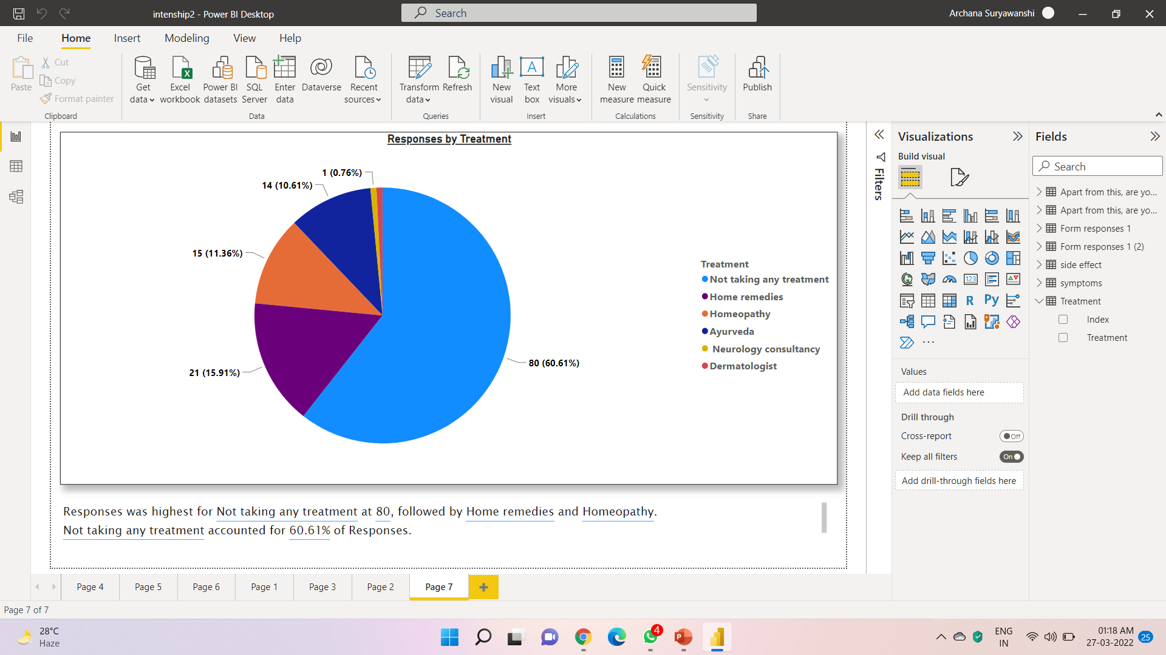

Slide 11

METHODOLOGY:
Recoding is done on categorical and ordinal scaled data. After recoding we summed all scores given to 8 questions of purchase intention and 4 questions of attitude.
Further regression analysis performed by taking purchase intention as dependent variable and attitude as independent variable.
Hypothesis
Hypothesis 1: There is no relationship between attitude and purchase intention
Hypothesis 2: There is no relationship between education and AT_V3 (i.e taking self medication without reading instruction)

Slide 12
ANALYSIS:
Descriptive Statistical Analysis
Age
 |  | Frequency | Percent | Valid Percent | Cumulative Percent
Valid | 20-29 | 102 | 85.7 | 85.7 | 85.7
 | 30-39 | 6 | 5.0 | 5.0 | 90.8
 | 40-49 | 8 | 6.7 | 6.7 | 97.5
 | 50 above | 3 | 2.5 | 2.5 | 100.0
 | Total | 119 | 100.0 | 100.0
Gender
 |  | Frequency | Percent | Valid Percent | Cumulative Percent
Valid | male | 52 | 43.7 | 43.7 | 43.7
 | female | 67 | 56.3 | 56.3 | 100.0
 | Total | 119 | 100.0 | 100.0
 |  | Frequency | Percent | Valid Percent | Cumulative Percent
Valid | below 200 | 72 | 60.5 | 60.5 | 60.5
 | 200-400 | 30 | 25.2 | 25.2 | 85.7
 | 401-600 | 6 | 5.0 | 5.0 | 90.8
 | 601-800 | 4 | 3.4 | 3.4 | 94.1
 | 800 above | 7 | 5.9 | 5.9 | 100.0
 | Total | 119 | 100.0 | 100.0
Place of Residence
 |  | Frequency | Percent | Valid Percent | Cumulative Percent
Valid | urban | 84 | 70.6 | 70.6 | 70.6
 | rural | 13 | 10.9 | 10.9 | 81.5
 | semi-urban | 22 | 18.5 | 18.5 | 100.0
 | Total | 119 | 100.0 | 100.0

Slide 13
Education
 |  | Frequency | Percent | Valid Percent |  | Cumulative Percent
Valid | Primary | 1 | .8 | .8 |  | .8
 | Secondary | 2 | 1.7 | 1.7 |  | 2.5
 | Higher secondary | 4 | 3.4 | 3.4 |  | 5.9
 | Graduation | 60 | 50.4 | 50.4 |  | 56.3
 | Post graduation | 51 | 42.9 | 42.9 |  | 99.2
 | other | 1 | .8 | .8 |  | 100.0
 | Total | 119 | 100.0 | 100.0
Income
 |  | Frequency | Percent |  | Valid Percent |  | Cumulative Percent
Valid | 0-1 lakh | 63 | 52.9 |  | 52.9 |  | 52.9
 | 1-5 lakh | 18 | 15.1 |  | 15.1 |  | 68.1
 | 5-10 lakh | 30 | 25.2 |  | 25.2 |  | 93.3
 | 10 lakh above | 8 | 6.7 |  | 6.7 |  | 100.0
 | Total | 119 | 100.0 |  | 100.0

Slide 14
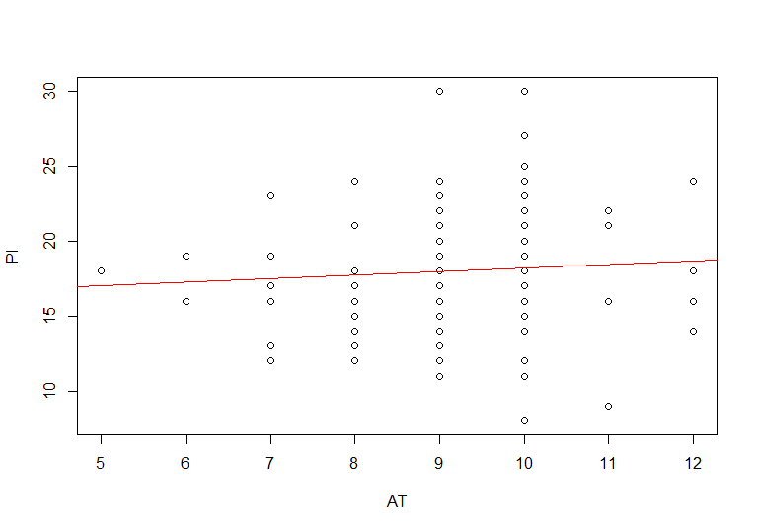
RESULT:
H01= There is no relationship between attitude and purchase intention
lm(formula = PI ~ AT, data = data)
Residuals:
Min 1Q Median 3Q Max
-10.2049 -2.7049 -0.4818 2.9156 12.0362
Coefficients:
Estimate Std. Error t value Pr(>|t|)
(Intercept) 15.795 2.948 5.358 4.28e-07 ***
AT 0.241 0.318 0.758 0.45
---
Signif. codes: 0 ‘***’ 0.001 ‘**’ 0.01 ‘*’ 0.05 ‘.’ 0.1 ‘ ’ 1
Residual standard error: 4.336 on 117 degrees of freedom
Multiple R-squared: 0.004885, Adjusted R-squared: -0.00362
F-statistic: 0.5744 on 1 and 117 DF, p-value: 0.45

Slide 15
H02= There is no relationship between education and AT_V3 (i.e taking self medication without reading instruction)
lm(formula = AT_V3 ~ Education, data = data)
Residuals:
Min 1Q Median 3Q Max
-0.4744 -0.3225 -0.1706 -0.1706 1.8294
Coefficients:
Estimate Std. Error t value Pr(>|t|)
(Intercept) 1.9302 0.3128 6.171 1.01e-08 ***
Education -0.1519 0.0709 -2.143 0.0342 *
---
Signif. codes: 0 ‘***’ 0.001 ‘**’ 0.01 ‘*’ 0.05 ‘.’ 0.1 ‘ ’ 1
Residual standard error: 0.5546 on 117 degrees of freedom
Multiple R-squared: 0.03776, Adjusted R-squared: 0.02953
F-statistic: 4.591 on 1 and 117 DF, p-value: 0.03421

Slide 16
CONCLUSION:
Majority of the respondents are in the age group of 20-29 years out of 119 respondents. Only 2.5% of the respondents are of the age Above 50. Majority of the respondents are female accounting to 56% whereas the male population shrinks to 43%.
50.4% of the respondents fall under the category of under graduate Whereas 42% of the respondents falls under category of post graduate. Means most of the respondents are well educated.
60.5% of the respondents spend between Rs. Below 200 on OTC medicines monthly and Only 5.9% of the respondents spend around Rs. 800+ monthly on OTC medicines
For H01 we got p- value = 0.45 which is greater than 0.05 hence we do not reject null hypothesis and conclude that there is no effect of Attitude on purchase intention
we got p-value=0.03<0.05 for H02 hence we reject null hypothesis and conclude that there is effect of education on AT_V3 . which means there is impact of education the people who are more educated they may do not take medications without reading labels which leads to less side effects from medicine

Slide 17
REFERENCES:
https://www.researchgate.net/publication/324208545_Consumer_Selection_and_Buying_Behaviour_Towards_Over_the_Counter_OTC_Medicine_in_Jaipur_City
https://en.m.wikipedia.org/wiki/Over-the-counter_drug
https://familydoctor.org/otc-medicines-know-your-risks-and-reduce-them/
https://m.timesofindia.com/life-style/health-fitness/health-news/know-your-medicine-types-of-painkillers/articleshow/71687590.cms
https://medlineplus.gov/ency/article/002208.htm

Slide 18
THANK YOU

